Slide 1

Open-Source Lunch Bites
Friday 7th November 2025
Friday 5th December 2025

Slide 2
Introduction
Open-Source Lunch Bites is a series of 30-minute monthly (first Friday) webinar lunch and learns designed to provide practical, bite-sized learning experiences.
Each session includes a 20-minute presentation/demonstration followed by a 10-minute Q&A, focusing on Open-Source skills relevant to the pharmaceutical industry.
The webinars will have tied-in resources for ongoing learning.
Join us each month to enhance your Open-Source knowledge in a convenient, pocket-sized format.

Slide 3
Topics
Why Open-Source Skills are Important – PSI AIMS SIG Website
Coding
Debugging
Packages
GitHub
Containers
AI use
Suggestions?

Slide 4
So Far…
Christina Fillmore – GSK
What is an IDE?
Debugging
Quick summaries to be made available on the website

Slide 5
Package Basics
An R package is an extension of R containing code, functions, data, documentation and tests to do specific things (e.g., analysis, manipulation)
A small number come with the original install (base) but others you install yourself
CRAN provides detailed information and manuals on the packages available
The Comprehensive R Archive Network (CRAN) is the main storage place for packages (18769 available) but other places are available too
What is a package?

Slide 6
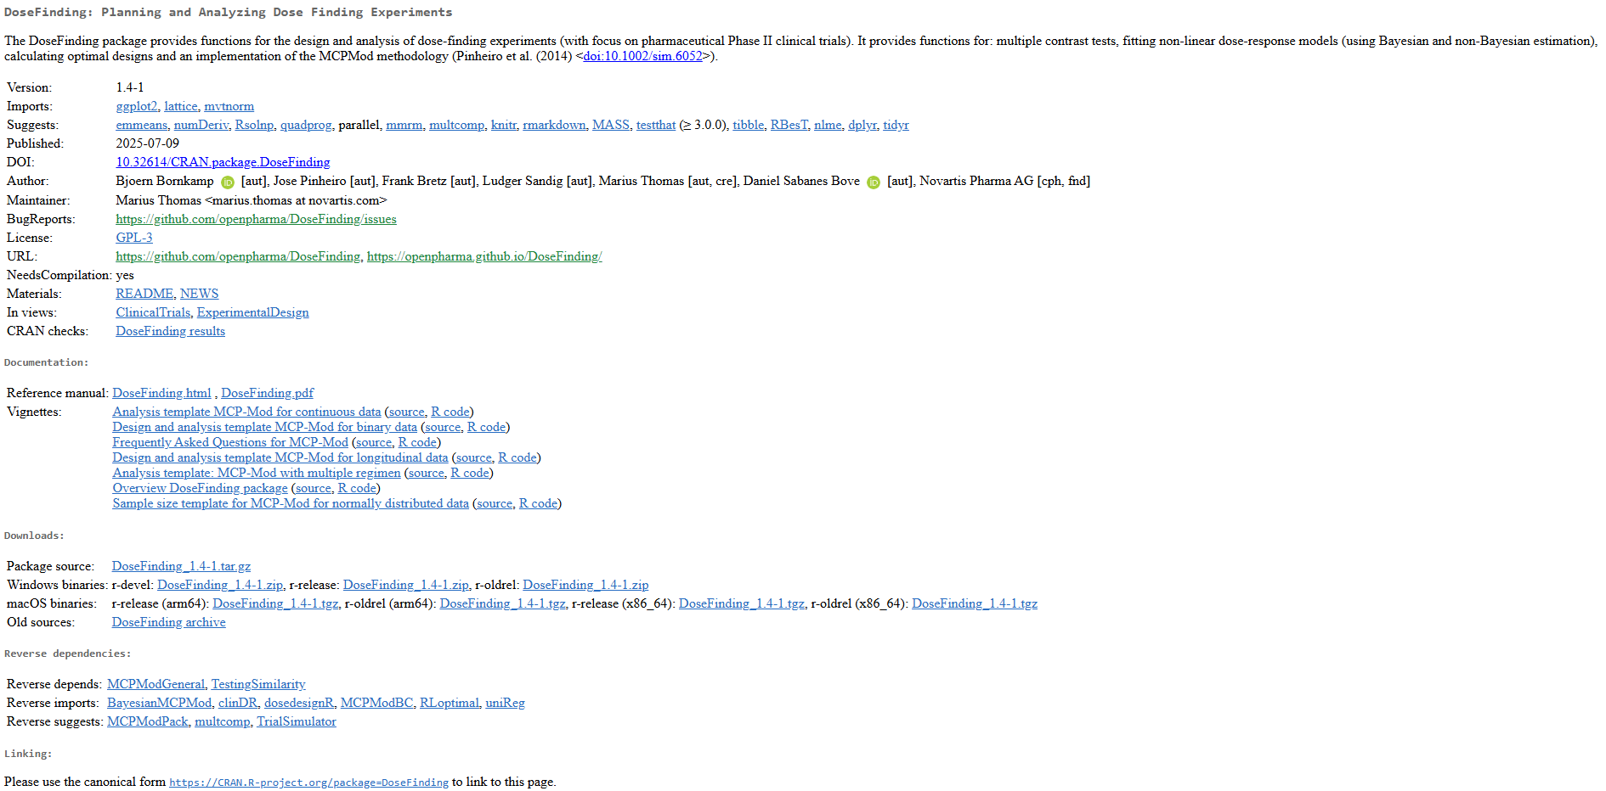
Package Basics
Package example
CRAN: Package DoseFinding

